Slide 1
Chapter 2 – Design and Implementation
Software Architecture and Design
Mutah University
Faculty of IT
Department of Software Engineering
Dr. Ra’Fat A. AL-Msie’Deen
rafatalmsiedeen@mutah.edu.jo
https://rafat66.github.io/Al-Msie-Deen/

Slide 2
References
Textbook
Title | Documenting Software Architectures: Views and Beyond
Author(s) | Paul Clements et al.
Publisher | Addison- Wesley
Year | 2010
Edition | 2nd Edition
Book Website
References | TBA in the class – refer to the website Ian Sommerville. Software Engineering (l0th Edition). Addison Wesley, 2015, ISBN-10: 0137035152.

Slide 3
Object-oriented design using the UML
System context and interactions
Architectural design

Slide 4
Architectural design
Once interactions between the system and its environment have been understood, you use this information for designing the system architecture.
You identify the major components that make up the system and their interactions, and then may organize the components using an architectural pattern such as a layered or client-server model.
The weather station is composed of independent subsystems that communicate by broadcasting messages on a common infrastructure.

Slide 5
Architectural design
Once the interactions between the software system and the system’s environment have been defined, you use this information as a basis for designing the system architecture.
Of course, you need to combine this knowledge with your general knowledge of the principles of architectural design and with more detailed domain knowledge.
You identify the major components that make up the system and their interactions.
You may then design the system organization using an architectural pattern such as a layered or client–server model.

Slide 6
Architectural design
The high-level architectural design for the weather station software is shown in Figure 1.
The weather station is composed of independent subsystems that communicate by broadcasting messages on a common infrastructure, shown as Communication link in Figure 1.
Each subsystem listens for messages on that infrastructure and picks up the messages that are intended for them.
This “listener model” is a commonly used architectural style for distributed systems.

Slide 7
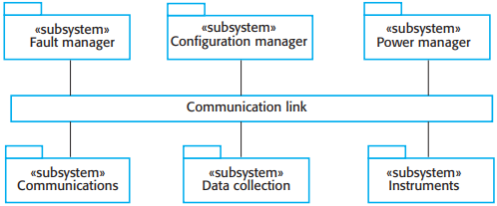
High-level architecture of weather station
Figure 1. High-level architecture of weather station.

Slide 8
Architectural design
When the communications subsystem receives a control command, such as shutdown, the command is picked up by each of the other subsystems, which then shut themselves down in the correct way.
The key benefit of this architecture is that it is easy to support different configurations of subsystems because the sender of a message does not need to address the message to a particular subsystem.

Slide 9
Architectural design
Figure 2 shows the architecture of the data collection subsystem, which is included in Figure 1.
The Transmitter and Receiver objects are concerned with managing communications, and the WeatherData object encapsulates the information that is collected from the instruments and transmitted to the weather information system.
This arrangement follows the producer–consumer pattern.

Slide 10
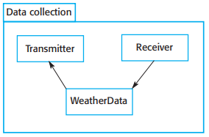
Architecture of data collection system
Figure 2. Architecture of data collection system

Slide 11
Definition
A real-time system is a software system where the correct functioning of the system depends on the results produced by the system and the time at which these results are produced.
An embedded system is a software system that is embedded in a hardware device e.g. the software system in a cell phone. Embedded systems are usually real-time systems and so have to respond in a timely way to events occurring in their environment.

Slide 12
Embedded system design
The design process for embedded systems is a systems engineering process that has to consider, in detail, the design and performance of the system hardware.
Part of the design process may involve deciding which system capabilities are to be implemented in software and which in hardware.
Low-level decisions on hardware, support software and system timing must be considered early in the process.
These may mean that additional software functionality, such as battery and power management, has to be included in the system.

Slide 13
Reactive systems
Real-time systems are often considered to be reactive systems.
Given a stimulus, the system must produce a reaction or response within a specified time.

Slide 14
Types of stimuli
Stimuli come from sensors in the systems environment and from actuators controlled by the system
Periodic stimuli These occur at predictable time intervals.
For example, the system may examine a sensor every 50 milliseconds and take action (respond) depending on that sensor value (the stimulus).
Aperiodic stimuli These occur irregularly and unpredictably and are may be signalled using the computer’s interrupt mechanism.
An example of such a stimulus would be an interrupt indicating that an I/O transfer was complete and that data was available in a buffer.

Slide 15
A general model of an embedded real-time system

Slide 16
Architectural considerations
Because of the need to respond to timing demands made by different stimuli/responses, the system architecture must allow for fast switching between stimulus handlers.
Timing demands of different stimuli are different so a simple sequential loop is not usually adequate.
Real-time systems are therefore usually designed as cooperating processes with a real-time executive controlling these processes.

Slide 17
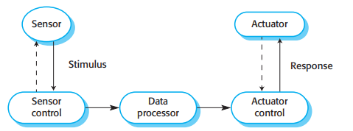
Sensor and actuator processes

Slide 18
System elements
Sensor control processes
Collect information from sensors. May buffer information collected in response to a sensor stimulus.
Data processor
Carries out processing of collected information and computes the system response.
Actuator control processes
Generates control signals for the actuators.

Slide 19
Design process activities
Platform selection
Stimuli/response identification
Timing analysis
Process design
Algorithm design
Data design
Process scheduling

Slide 20
Process coordination
Processes in a real-time system have to be coordinated and share information.
Process coordination mechanisms ensure mutual exclusion to shared resources.
When one process is modifying a shared resource, other processes should not be able to change that resource.
When designing the information exchange between processes, you have to take into account the fact that these processes may be running at different speeds.

Slide 21
Mutual exclusion
Producer processes collect data and add it to the buffer. Consumer processes take data from the buffer and make elements available.
Producer and consumer processes must be mutually excluded from accessing the same element.
The buffer must stop producer processes adding information to a full buffer and consumer processes trying to take information from an empty buffer.

Slide 22
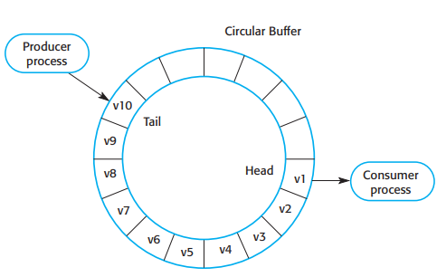
Producer/consumer processes sharing a circular buffer
Figure 3. Producer/ consumer processes sharing a circular buffer

Slide 23
Architectural patterns for real-time software

Slide 24
Architectural patterns for embedded systems
Characteristic system architectures for embedded systems
Observe and React This pattern is used when a set of sensors are routinely monitored and displayed.
Environmental Control This pattern is used when a system includes sensors, which provide information about the environment and actuators that can change the environment
Process Pipeline This pattern is used when data has to be transformed from one representation to another before it can be processed.

Slide 25
The Observe and React pattern
Name | Observe and React
Description | The input values of a set of sensors of the same types are collected and analyzed. These values are displayed in some way. If the sensor values indicate that some exceptional condition has arisen, then actions are initiated to draw the operator’s attention to that value and, in certain cases, to take actions in response to the exceptional value.
Stimuli | Values from sensors attached to the system.
Responses | Outputs to display, alarm triggers, signals to reacting systems.
Processes | Observer, Analysis, Display, Alarm, Reactor.
Used in | Monitoring systems, alarm systems.

Slide 26
Observe and React process structure

Slide 27
The Environmental Control pattern
Name | Environmental Control
Description | The system analyses information from a set of sensors that collect data from the system’s environment. Further information may also be collected on the state of the actuators that are connected to the system. Based on the data from the sensors and actuators, control signals are sent to the actuators that then cause changes to the system’s environment. Information about the sensor values and the state of the actuators may be displayed.
Stimuli | Values from sensors attached to the system and the state of the system actuators.
Responses | Control signals to actuators, display information.
Processes | Monitor, Control, Display, Actuator Driver, Actuator monitor.
Used in | Control systems.

Slide 28
Environmental Control process structure

Slide 29
The Process Pipeline pattern
Name | Process Pipeline
Description | A pipeline of processes is set up with data moving in sequence from one end of the pipeline to another. The processes are often linked by synchronized buffers to allow the producer and consumer processes to run at different speeds. The culmination of a pipeline may be display or data storage or the pipeline may terminate in an actuator.
Stimuli | Input values from the environment or some other process
Responses | Output values to the environment or a shared buffer
Processes | Producer, Buffer, Consumer
Used in | Data acquisition systems, multimedia systems

Slide 30
Process Pipeline process structure

Slide 31
The architecture of IMMITN software system
The architecture of a software system may be documented from different views (logical, development, process, or physical).
For example, a software architect can document the software’s architecture from a conceptual view.
The software architectural view is an explanation of a software architecture from a specific view.
It is impossible to give all information around a software architecture in one diagram, as an architectural model can just display one view of the software.

Slide 32
The architecture of IMMITN software system
The conceptual view is an abstract view of the software that can be the base for decomposing user requirements into detailed software specifications.
Conceptual view aids software developers make choices about components that can be reused in similar products (software product line).
Figure below, which defines the architecture of IMMITN product, is an instance of a conceptual software view.

Slide 33
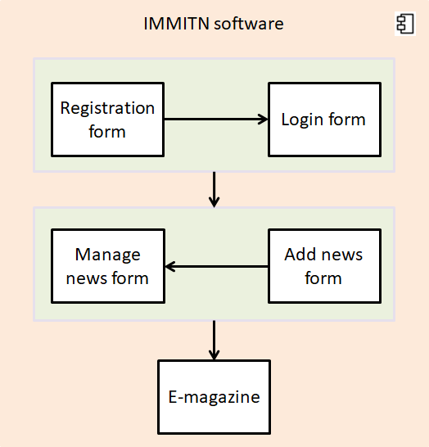
The architecture of IMMITN software system

Slide 34
The architecture of IMMITN software system
The conceptual view of software is developed in the software design process.
Software engineer uses this view to explain the software architecture to different stakeholders.
The main goal of using conceptual architecture view in this study is to identify the main components of the proposed software and to capture the main relationships between those components.

Slide 35
Object-oriented design using the UML
System context and interactions
Architectural design
Object class identification
Design models

Slide 36
Chapter 2 – Design and Implementation
Software Architecture and Design
Mutah University
Faculty of IT
Department of Software Engineering
Dr. Ra’Fat A. AL-Msie’Deen
rafatalmsiedeen@mutah.edu.jo
https://rafat66.github.io/Al-Msie-Deen/

